Slide 1
O.N.E Workshop, Ankara, 21 March 2018

Slide 2
Agenda
Introduction
About OECD
What is the OECD Network Environment (O.N.E)
In-depth O.N.E Demonstration
Support Resources
Questions & Answers

Slide 3
A Global Governmental Organisation
sharing knowledge
to raise living standards
Notes:
Increase awareness of the OECD
Demo of ONE – leave with the potential of info available & getting most of the system

Slide 4
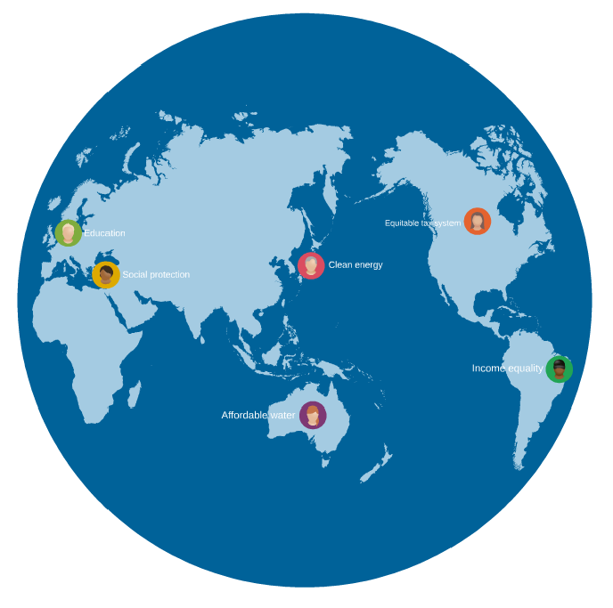
Better policies for better lives
A Global
Policy Network
To improve national policies
Create international standards
Raise living standards

Slide 5

Spanning a variety of policy areas
Advice & Global Standards
Economics
Agriculture
Competition
Technology
Energy
Social Issues
Education
Financial Affairs
Entrepreneurship
From taxes …
… to tractors
Science
Work-life balance
Taxes
Environment
Tractors
Health
Governance
Development
Trade
Employment

Slide 6
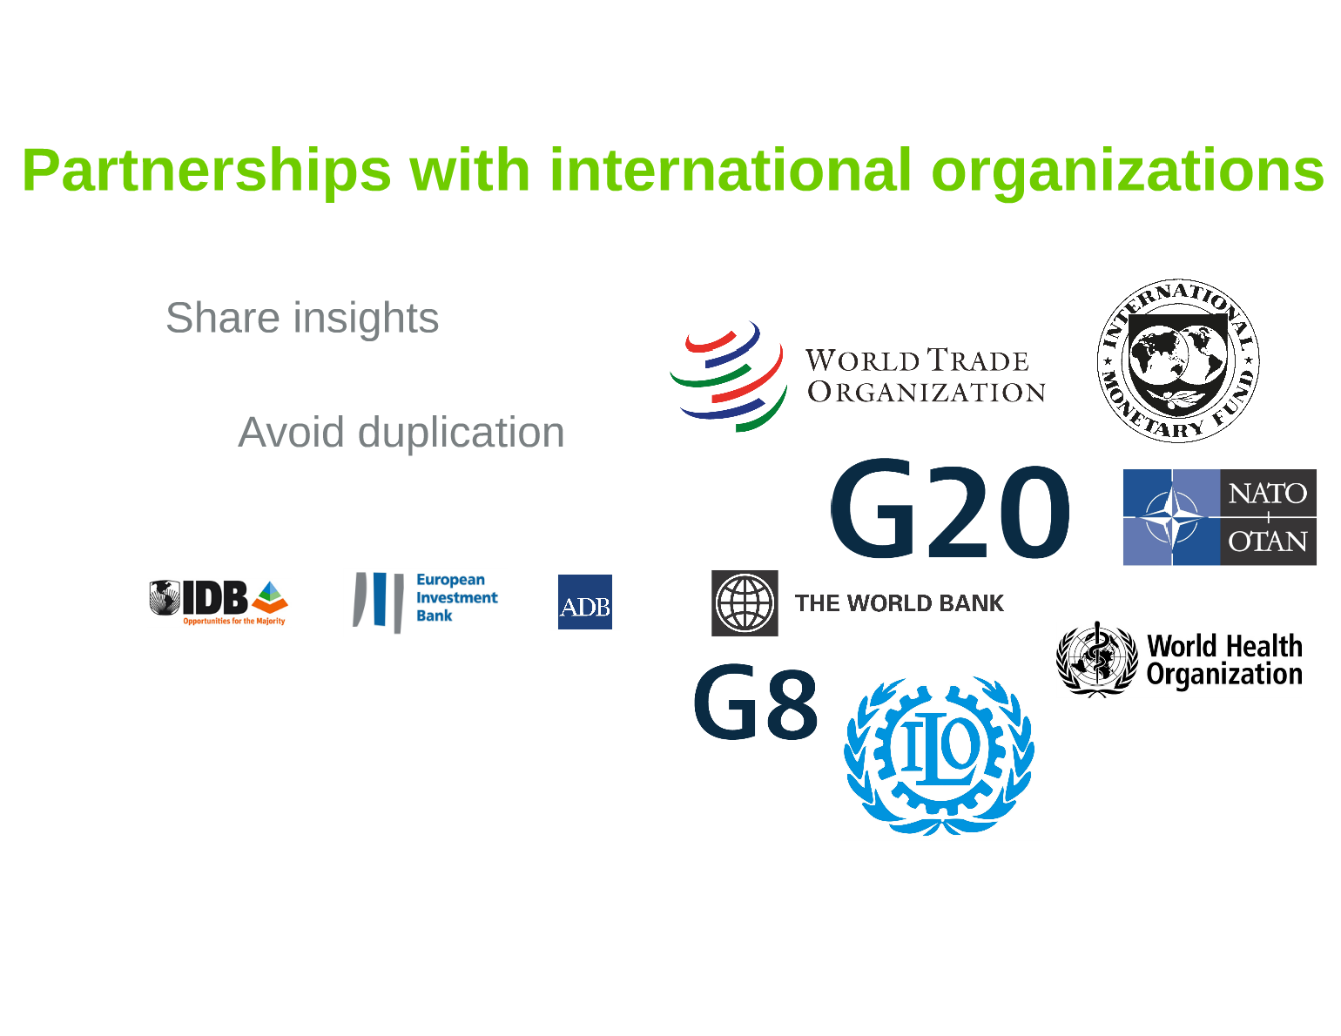

Partnerships with international organisations
Not an exhaustive list

Slide 7
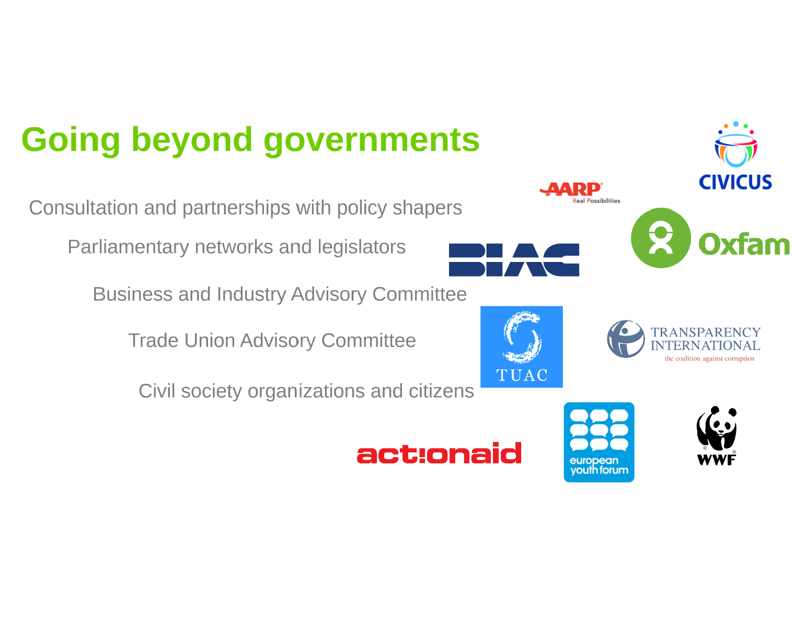
Going beyond government
Consultation and partnerships with policy shapers
Parliamentary networks and legislators
Business and Industry Advisory Committee
Trade Union Advisory Committee
Civil society organisations and citizens

Slide 8
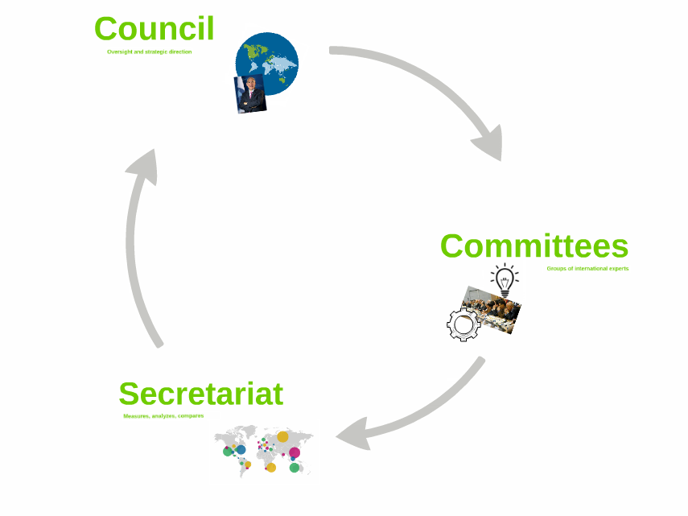

Who Does What?
Council
Oversight & strategic direction, decisions
committees
Groups of international experts
secretariat
Measures, analyses,
compares, recommends,
supports
Notes:
250 committees
40,000+ experts
Exchange info, monitor progress, request/review/contribute to secretariat work

Slide 9
OECD’s Way of Working
Data collection
Analysis
Discussion
Decisions
Implementation
Peer reviews,
multilateral surveillance

Slide 10
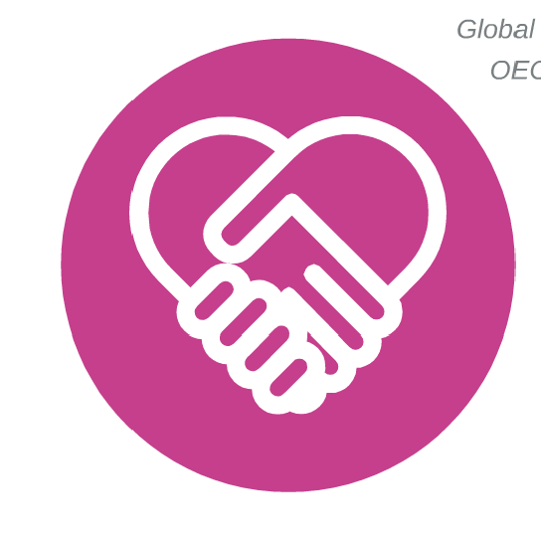
OECD eco-system
Legal instruments - Examples
Soft Law: Global Standards of Conduct
Countries agree to aspire to higher standards
  Global Forum of Transparency & Exchange of
  Information for Tax Purposes
  OECD Anti-Bribery Convention
Formal promise upheld by peer pressure
  OECD Working Group on Bribery
Standards implemented via national legislation
  2011 UK Bribery Act
  Base Erosion & Profit Shifting (BEPS) legislation in all OECD & G20 countries
* OECD Legal Instruments & Database

Slide 11

OECD Committee Work
1,884
Official meetings
2017 Key Figures
44
Main committees
OECD
COMMITTEES
258
Subsidiary bodies
41,664
Member country registrations
52,294 with Delegations
* OECD Committees

Slide 12


OECD & Turkey
2017
 |  | Members Avg. | Total
Committee Chairs | 1 | 9 | 206
Vice-chairs | 5 | 13 | 382
Meeting Registrations
National Delegates | 1,080 | 1,156 | 41,628
Delegation Staff | 231 | 284 | 10,233
O.N.E / OLIS
Unique Users | 408 | 237 | 9,527
Sessions | 8,003 | 6,820 | 282,517
Documents Downloaded | 14,120 | 12,601 | 543,765

Slide 13
O.N.E Background & design Process
O.N.E Context
Value for Money (V4M)
Action Plan
Council Working Group on Governance
Digital Strategy
Call for OLIS Renewal
Online Survey
  Delegations
  Delegates
  Government Officials
  OLIS users at large
Features based on feedback
  Access from anywhere via tablet/smartphone
  Find documents & related information
  Online Help, look & feel, ease of use
  Enhanced committee collaboration
Bring all info together in same interface
  Official documents
  Events
  Publications
  Committee & policy communities
Development thru Consultation
Engagement
  Delegation Contact Group
  Committee meetings & Delegates
  Workshops in capitals, via webinar
Continuous Improvement
  Track feedback
  Analyse
  Communicate & collaborate
  Make changes

Slide 14
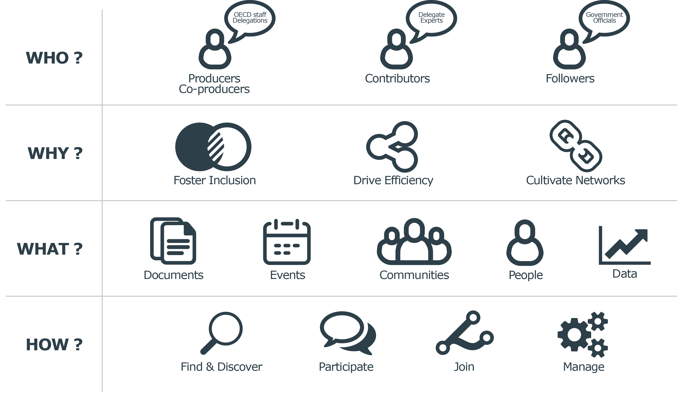
What is O.N.E?
Enable sharing & knowledge creation
Enhance engagement for a global policy community

Slide 15

O.N.E Overview
Notes:
Insert “Introducing ONE” video https://oecdtv.webtv-solution.com/3731/or/video/new_one_mps_video.html

Slide 16
In-depth O.N.E Demo
 | Subject | What is covered
1 | Logging in | MyOECD vs OLIS account
2 | Home page | Tiles Default personalisation
3 | Customisation | Personal details Interface language , Search results language Home page & tiles
4 | Search | By reference , By Committee Filters Saving searches
5 | Events | Prepare my next meeting Sharing the event, add event to calendar Get Paris Conference Centre access code Get all the documents Who else is going? Related communities
6 | Advanced Search | Date range, title Document versions Related documents History Favourites
7 | Email alerts | How to create
8 | Accessing | Tablet or smartphone

Slide 17
O.N.E Support Resources
Getting Help & Giving Feedback
Getting an account
O.N.E Support
  one@oecd.org
  +33 (0)1 45 24 83 00
  Interactive Tutorials and Frequently Asked Questions (FAQs)
Feedback Community
How to join & other resources:
  http://www.oecd.org/one
Notes:
Google translate integrated

Slide 18
Questions & Answers

